Slide 1
IBM University Engagement Project Submission
“Exploring the Power of Agentic AI with IBM Cloud and Orchestrate”

Slide 2

Project Tile – Agentic AI for Mental Health Awareness & Suicide Prevention
Domain of Project – Health Care
Student Name | Recent Passport Photo | Email ID | Mobile number [WhatsApp]
Ruturaj Pravin Gandhi |  | ruturajgandhi1@gmail.com | 8446454014

Slide 3
Problem Statement -
Problem Statement : Agentic AI for Mental Health Awareness & Suicide Prevention The Challenge- Mental health issues such as depression, anxiety, and suicidal thoughts are growing worldwide. Stigma, lack of awareness, and limited access to timely help prevent many individuals from seeking support. Traditional systems are often reactive, leaving gaps in early detection and preventive care. The Objective Build an Agentic AI-powered Mental Health Awareness & Suicide Prevention Agent that is empathetic, proactive, and safe. The solution should: 1. Promote Awareness & Education – Share accessible resources on mindfulness, coping strategies, and self-care. 2. Enable Early Detection (RAG) – Use Retrieval-Augmented Generation to identify distress signals in conversations, journaling inputs, or safe online data. 3. Provide Empathetic Support – Build a conversational agent that listens actively and responds with empathy (with clear disclaimers: not a substitute for professional medical advice). 4. Predict & Prevent Risks – Forecast stress peaks, suggest preventive strategies, and issue alerts when high-risk signals are detected (with consent). 5. Connect to Human Support – Link users to helplines, counselors, or community support for timely intervention. Tech Stack (Mandatory) • IBM Langflow / IBM Orchestrate + IBM Models

Slide 4
Proposed Solution -
Proposed Solution: AI-Powered Mental Health Support Agent (MindGuard)
MindGuard is a multi-agent AI-powered mental health assistant built using LangFlow, IBM watsonx.ai, and Granite Models to promote mental health awareness, provide empathetic support, enable early distress detection, and assist in suicide prevention.
The solution uses a Retrieval-Augmented Generation (RAG) pipeline to retrieve reliable mental health information from trusted sources such as WHO and NIMH. The knowledge is stored in a vector database, enabling accurate, context-aware guidance on stress management, mindfulness, and emotional well-being.
Key Agents:
Knowledge Agent: Retrieves evidence-based mental health resources using RAG.
Emotional Support Agent: Provides empathetic conversations, self-care tips, and personalized coping strategies.
Risk Detection Agent: Identifies signs of emotional distress from conversations or journal entries, predicts stress levels, and issues alerts (with user consent).
Crisis Support Agent: Connects users to counselors, helplines, or emergency support when high-risk situations are detected.
A Streamlit/React dashboard visualizes mood trends, stress levels, journaling insights, and wellness progress. LangFlow orchestrates agent workflows, watsonx.ai ensures scalable AI deployment and governance, while Granite Models power reasoning, emotional understanding, and personalized recommendations.
Overall, MindGuard provides a secure, intelligent, and compassionate mental health support system that encourages early intervention, preventive care, and timely access to professional help.

Slide 5
Technology Used
Langflow platform -For designing and orchestrating multi-agent workflows visually
IBM Granite model - for eg – ibm-granite-3-2-8b – For natural language understanding, reasoning, and personalization
IBM Cloud – It provides the secure and scalable infrastructure to build, deploy, and manage the MindGuard AI system. IBM Cloud enables reliable hosting, seamless integration of AI services, and efficient scaling to deliver real-time mental health support and risk detection.
IBM Watsonx.ai - For model deployment, embeddings, and AI governance

Slide 6
Orchestrate component Used -
Chat Input – Captures user messages, emotions, journal entries, and mental health concerns through text or voice.
IBM Langflow / IBM Orchestrate Agent – Manages AI workflows for conversation analysis, support generation, risk detection, and resource retrieval.
IBM Granite Model – Granite-4.0-8B-Instruct – Generates empathetic responses, identifies distress signals, and provides mental health guidance.
RAG Component – Retrieves trusted mental health resources, coping strategies, and crisis support information.
Chat Output – Displays empathetic responses, self-care suggestions, awareness content, and professional help recommendations.
File Component – Stores consent-based user data, mood logs, and mental health resource datasets.
Risk Detection & Alert Component – Identifies high-risk signals and suggests timely intervention with user consent.
Human Support Integration – Connects users with counselors, helplines, and community support services.

Slide 7
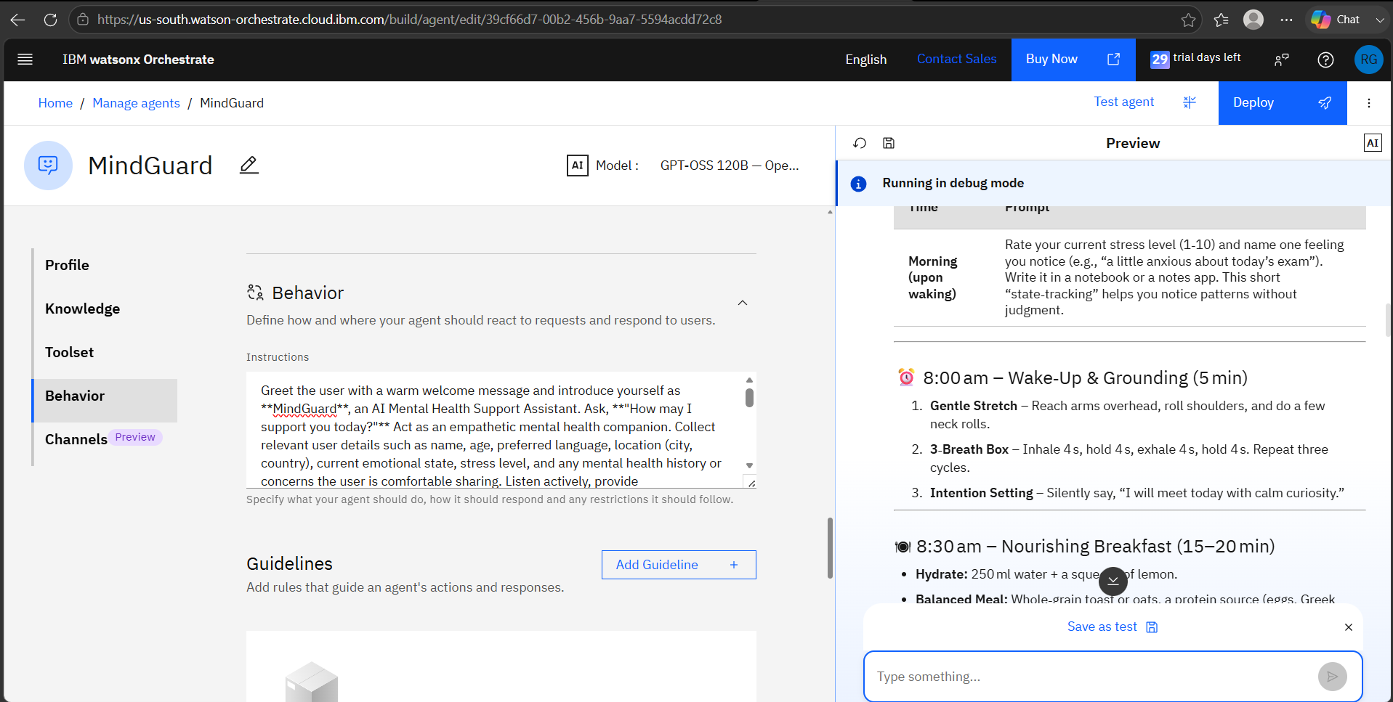
Agent Instructions Screenshot-

Slide 8
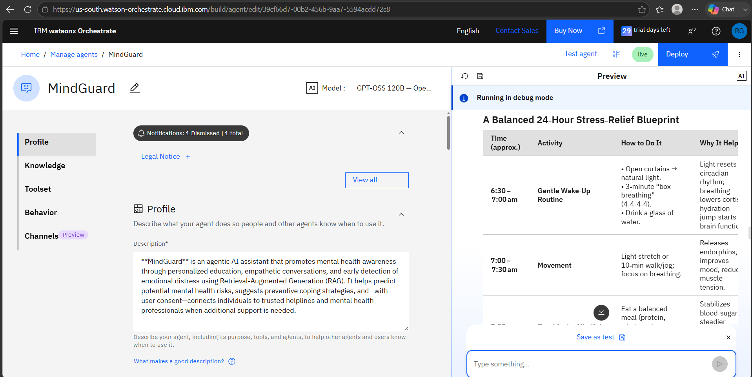
Prompt with output Screenshot:

Slide 9

Role of Agentic AI in the solution
Role of Agentic AI in Mental Health Awareness & Suicide Prevention Agent
Agentic AI enables the Mental Health Agent to work as an intelligent and proactive support system rather than a simple chatbot. Using IBM Langflow/IBM Orchestrate and IBM Granite models, it coordinates multiple agents for emotional analysis, RAG-based resource retrieval, risk detection, and personalized support.
Each agent handles specific tasks such as identifying distress signals, providing coping strategies, sharing mental health resources, and connecting users with professional help.
With context awareness and real-time adaptation, the system understands user emotions and changing needs to deliver safe, personalized guidance.
Overall, Agentic AI makes the solution empathetic, preventive, and goal-oriented, acting as a digital mental health companion for awareness and timely support.

Slide 10
Novelty and Uniqueness
The proposed Mental Health Agent combines Agentic AI, RAG, and personalization to create an intelligent and supportive mental wellness system.
Multi-Agent Intelligence – Multiple specialized agents collaborate for emotional analysis, resource retrieval, risk detection, and personalized support.
RAG-Based Reliability – Uses trusted mental health resources with AI generation to provide accurate and safe guidance.
Personalized Support – Adapts responses based on user emotions, conversations, and mental health needs.
Real-Time Risk Monitoring – Detects distress patterns and provides timely preventive suggestions with user consent.
Multi-Modal Interaction – Supports text, voice, and journaling inputs for accessible mental health assistance.
Preventive Mental Healthcare Focus – Promotes awareness, mindfulness, coping strategies, and early intervention.
Scalable & Secure System – Built using IBM Langflow/IBM Orchestrate and IBM Granite models for reliable AI-driven support.
This makes the solution an empathetic, proactive, and adaptive digital mental health companion that supports awareness, early detection, and timely human connection.

Slide 11
Future Scope
Wearable & Health Device Integration – Collects real-time data like sleep, stress levels, and activity patterns to provide timely mental wellness support.
AI Voice Assistant & Multilingual Support – Enables natural conversations in multiple languages, improving accessibility and inclusiveness.
Predictive Risk Analysis – Uses AI to identify emotional patterns and detect potential risks early for preventive intervention.
Professional Support Integration – Connects users with counselors, therapists, and helplines during critical situations.
Personalized Wellness Plans – Generates customized mindfulness, coping, and self-care strategies based on user needs.
·
·
·

Slide 12
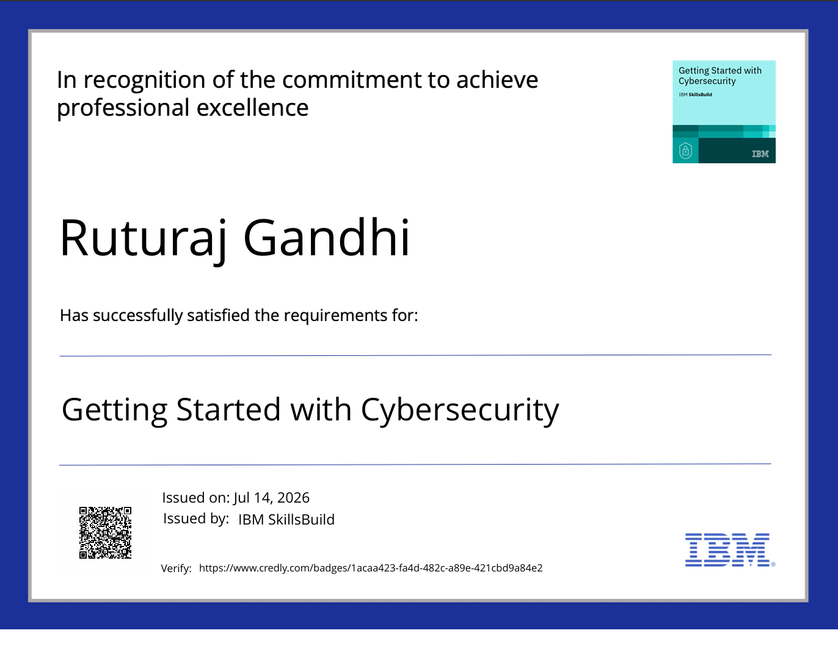
Certificates Earned:

Slide 13
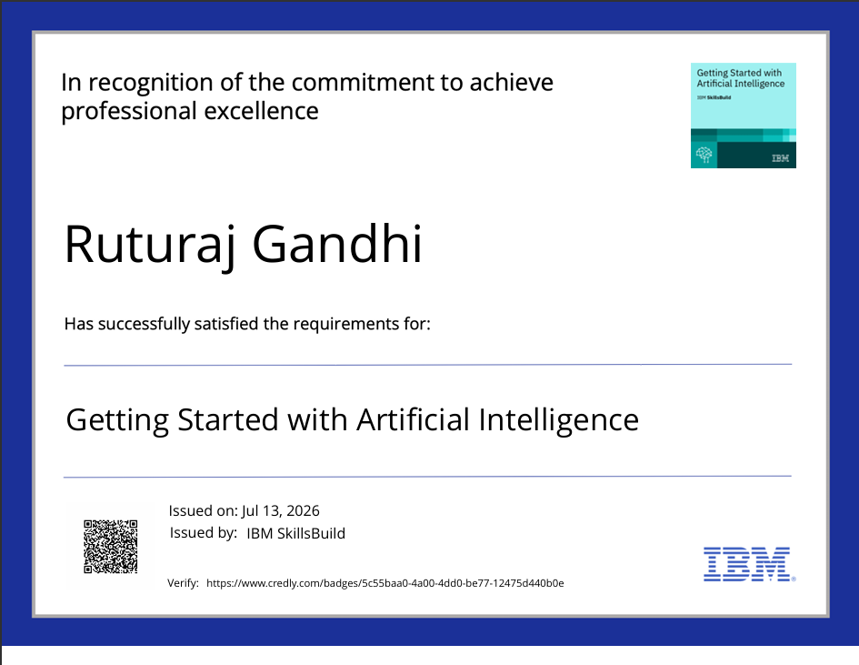
Certificates Earned:

Slide 14
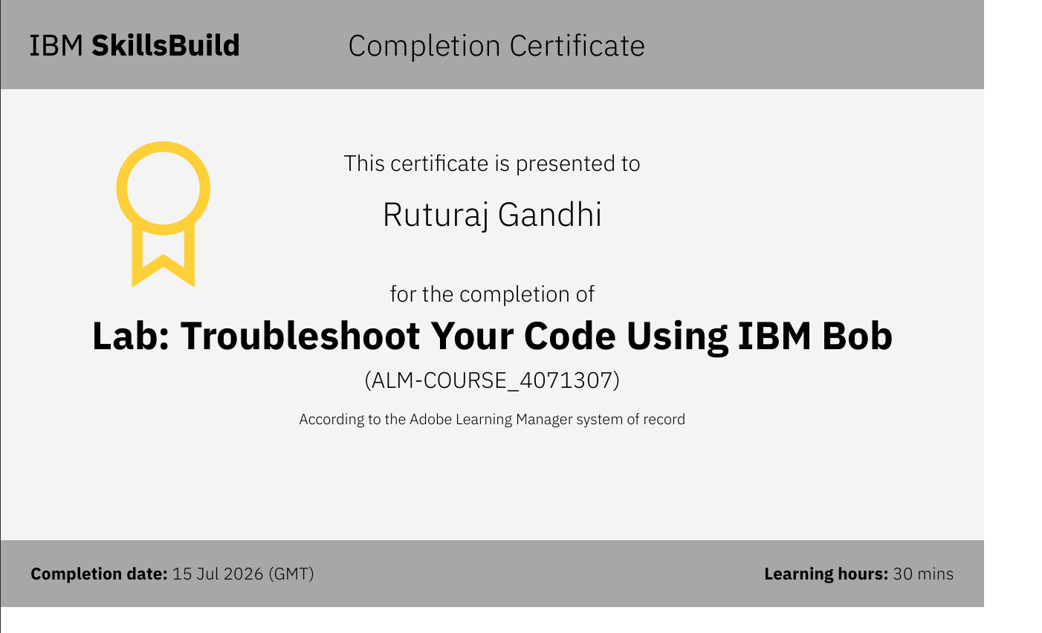
Certificates Earned:​

Slide 15
Git Hub Link
Please create public github repository (Enable Add README button while creating repository) with format –
Please test and Paste the working Github URL –ruturajgandhi1-oss/MindGuard
·
·
·

Slide 16


